Slide 1


Activating
Research
Steve Hansen, Partner
May 2021
Notes:
Good afternoon or morning or lunchtime everyone, thanks so much for taking the time to log on to yet another virtual meeting and endure the inevitable technical glitches.
My name is Steve Hansen. I am a partner and head of the data analytics practice at Phase 5, and I am going to talk to you about JTBD.
By way of background, I came to JTBD as a skeptic. It was 2005 or so. I was in market research at Thomson Reuters, a big information services company. There was a new book on the market that purported, once again, to solve the problem of innovation that people had been talking about for years, that problem that gazillions of new products – innovations that smart people have worked very hard to create – ultimately fail in the market.
I dutifully read the book. People were talking about it in the industry. I was somewhat interested at first. Our company even talked with the author’s company about potentially doing a project. But I concluded in the end this was a repackage. Like so many other fads it was just yesterday’s lunch put back in the skillet.
Now that book was based on JTBD and that was my first introduction to the concept. And I’m going to come back to that book at the end of the presentation.
But first, let’s fast-forward now 15 years. It’s 2020 and I’ve been working with JTBD in various forms for actually a dozen years or so.
So clearly my attitude changed, and it changed pretty soon after that first encounter.
I’m going to walk you through my change of heart, because I think it helps do what I promised we would do when I sent out my intro video for this presentation.

Slide 2
Overview
Why we’re here
It’s not just a “session”
Activation session structure

Slide 3
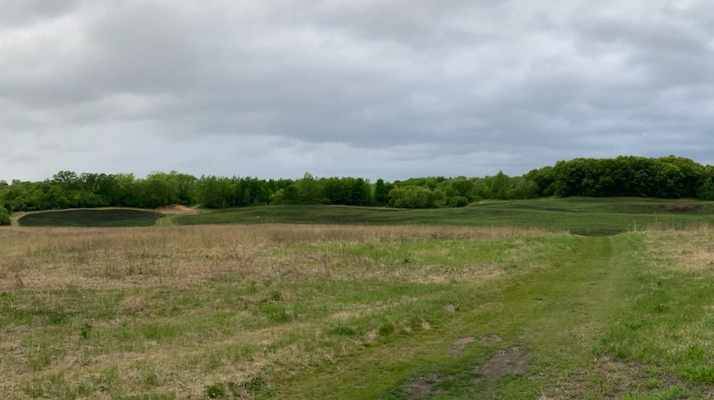
It’s not enough to show the grass is greener…
Insights Team
JTBD
Low
-
functioning
Pull weeds, apply chemicals
High
-
functioning
Show where the grass is greener
Zen
Teach teams to landscape

Slide 4
Overview
Why we’re here
It’s not just a “session”
Activation session structure

Slide 5
The context for activation sessions
Analyze
Scope project size
Kickoff
Communicate key insights
Implement
Collaborate departmentally for how relevant insights will be implemented
Assess audiences and affected departments
Inspire for the task ahead
The Activation session is here

Slide 6
Analyze
1. Analyze scope and audiences
  How big is the project scope?
    Does the entire company need to be involved or only specific departments?
    Commonly, certain areas will only need cursory knowledge while others need a deep dive
  Who needs to be involved?
    Marketing
    Product development
    Sales
    Customer service / Support
    Digital & Web [They often struggle with segmentations and how to implement]
    Brand

Slide 7
Analyze
2. Determine how to communicate the [thing that’s being activated]
  What does each group need to know?
  How can we best help them understand it?
  Ensure the “why” effectively comes through
    Impetus for doing this work
    What it will do for us
    Elevator speech
  Do we need to test the method of communication? (e.g. video communication, expensive but effective)
3. Dedicate some level of “air cover” to support communication
  Just as ground troops in combat are often supported with air cover during battle, intentional messaging by leadership / department heads will serve to support activation efforts

Slide 8
Deliverable from the Analyze phase: Roll Out Plan
AUDIENCE | COMMUNICATION | SUGGESTED AIR COVER
Senior Leadership Experience Leaders -Steering Committee | 30 min in-person overview by sponsoring Leader Content: Experience Architecture insights Activation Roll Out plan 1 hr presentation by Activation Team Content: Experience Architecture insights; integration w/latest brand work Examples of practical application of the Experience Architecture Experience success story in our industry Activation Roll Out plan | Monthly updates to Senior Leadership from the Leader sponsoring Activation efforts Quarterly ‘Moment’ implementation reports presented by Experience Design teams Customer Moments brought to you by Experience Design team; periodic emails of short customer experience successes

Slide 9
Deliverable from the Analyze phase: Roll Out Plan
AUDIENCE | COMMUNICATION | SUGGESTED AIR COVER
Managers | 2 hour Intro Session by department(?) presented by Activation Team Content: Short “importance of this work” kickoff video from senior leadership + elements of above presentation Interactive learning exercises to convey practicality of Experience Architecture Experience success story in our industry Review preliminary plan for introducing Roll Out Plan to their teams; tweak and set calendar together | Bi-monthly email from Leader sponsoring Activation to send encouragement and call out individual stories from roll out Customer Moments brought to you by Experience Design Team

Slide 10
Deliverable from the Analyze phase: Roll Out Plan
AUDIENCE | COMMUNICATION | SUGGESTED AIR COVER
Frontline Employees | 1 hour Intro sessions presented by Activation Team Content: Leadership video; key presentation elements from above Learning exercises tailored to department to convey practicality of Experience Architecture Review specific ways Activation will affect dept Collaborate on implementation timing | Customer Moments brought to you Experience Design Team Customer Experience Employee of the month/quarter/year Annual Customer Experience Day

Slide 11
Deliverable from the Analyze phase: Roll Out Plan
AUDIENCE | COMMUNICATION | SUGGESTED AIR COVER
New Employees | Experience Architecture learning bites integrated into New Employee Orientation Quality & Service Training Any other dedicated new employee training | Welcome email experience Design Team

Slide 12
Kickoff
1. Hold a dedicated ‘launch’ of the project
  Can range from from small to big depending on scope
    A bank we worked with:
    created a Customer Museum in HQ lobby; CEO required all employees to experience it
  An insurance company we worked with:
    held a series of Lunch and Learns for the departments that would be touched by the work
2. Execute specific Kickoff elements of the Roll Out Plan
  Include highest executive involvement possible to inspire, set expectations, show that the company takes it seriously

Slide 13
Activation Session
Hold Activation session(s) for departments / teams touched by the work
  One department per session, no need to be cross-functional
  Goal of sessions
    Digest the thing we are trying to activate
    Provide plenty of time for people to get to the ‘aha’ through the work that’s been done
    Ideate on how it fits in YOUR department, YOUR world
    Collaboratively set timelines and working groups for implementation
2. Potential Outputs
  Department-relevant playbooks illustrating different use cases
  Guidance around structures for segment support, e.g. “segment champions” who know the persona best, advocate for them like a lawyer defending a client
  Follow-on communication and training plans to highlight the work; increase empathy for Segment X

Slide 14
Overview
Why we’re here
It’s not just a “session”
Activation session structure

Slide 15
Activation Session
Hold Activation session(s) for departments / teams touched by the work
  One department per session, no need to be cross-functional
  Goal of sessions
    Digest the thing we are trying to activate
    Provide plenty of time for people to get to the ‘aha’ through the work that’s been done
    Ideate on how it fits in YOUR department, YOUR world
    Collaboratively set timelines and working groups for implementation
2. Potential Outputs
  Department-relevant playbooks illustrating different use cases
  Guidance around structures for segment support, e.g. “segment champions” who know the persona best, advocate for them like a lawyer defending a client
  Follow-on communication and training plans to highlight the work; increase empathy for Segment X

Slide 16
Walk through TR Tax & Accounting example

Slide 17

Onvio Research Activation Sessions
REUTERS / Harrison McClary
February 2021

Slide 18
Agenda Day 1
Kickoff | 0:00 – 0:10
End goals and agenda | 0:10 – 0:20
Key findings presentation | 0:20 – 0:50
BREAK | 0:50 – 1:00
Aha! Breakout groups | 1:00 – 1:20
Product Obituary breakout groups | 1:20 – 1:40
BREAK | 1:40 – 1:50
Report-out | 1:50 – 2:40
Wrap-up | 2:40 – 2:55

Slide 19
Look for aha!
Take a moment to jot down at least 3 ahas for each of the five key findings areas as we review. Ahas could be:
something unexpected;
something unusual;
a hypothesis you had that turned out to be true; or
a hypothesis you had that turned out to be false.
We will use the aha! collection in the next segment of today’s program

Slide 20
Day 1 team assignments
Advisory | Audits | Bookkeeping | Data Collection | Mental Model
Eric Neveu | Melissa Yard | Jessica Ockerman | Diane Vince | Mark Purdue
Jamie Krumrich | Glenn Tucker | Ian Cooper | Richard Puffe | Kim Gardener
Linda Kerhoulas | Pam Riley | Shane Paxton | Joanne Griffith | Nancy Hawkins
Jennifer Winters | Sara Vassar | Dave Pearson | Tania Beech | Pushkar Bhoopalam
Shannon O’Brian | Veena Hammers | Chris Post | Charlie Claxton | Jeff Krzeminski

Slide 21
Report-out on thinking from Aha! and Obituary exercises
People
          Spokesperson – to present
          Note-taker – to add comments
Aha!
          Talk through each of the top Ahas
          Answer questions from the other teams
          OTHER TEAMS: if you have Ahas that were not addressed, please add a sticky alongside
Obituary
          Review each obituary
          Answer questions from the other teams

Slide 22
Agenda Day 2
Kickoff | 0:00 – 0:10
Biggest customer problems | 0:10 – 1:15
BREAK | 1:15 – 1:30
Specific solution ideation | 1:30 – 2:10
Specific solution report-out and discussion | 2:10 – 2:50
Wrap-up | 2:50 – 3:00

Slide 23
Guidelines for Making the Day Most Productive
Don’t shy away from your opinions, but use the evidence, work from insights.
Our Miro board is the hub of all collaboration:
      https://miro.com/app/board/o9J_lU3AhHw=/
      Password: onvio11feb

Slide 24
Biggest problems – all alone for 12 minutes
What are the biggest problems faced by accounting firms
________ firm leaders need to take care of __________________ or else ______________
[type of] [problem to solve] [consequence]
Goal: your top 5-7 problems to solve
Good information sources…
“most like to automate” e.g. slide 27
“future areas of revenue growth” 28
“pain points in working with clients” 38
“holding your business back” 39

Slide 25
Biggest problems – large group consolidation
Process
Group A presents first idea
Group B presents their first idea – unless it’s already up
Etc.

Slide 26
Assignment: Yes And, Yes But…
Present your list of ideas…
If we want the Onvio team to reach its greatest creative potential, we need to invest in an-all team trip to Tahiti next year.
A brainstorming warm-up:
Take turns around the group
The first person adds to this statement using the words ‘Yes, and’ or ‘Yes, but’
Every subsequent participant in your team must add to this idea by starting their sentence with ‘Yes, and’ or ‘Yes, but’
Continue until every person has shared two ideas.
Just type on the sticky
Be sure to BUILD ON the total idea, not just the original idea

Slide 27
Discussion: Yes And, Yes But…
Which teams got further, those doing yes and or yes but?
Did anyone feel their ideas were rejected? Why?
Does it help to speak? What if you were not allowed to speak?
On which team would you prefer to work?

Slide 28

Questions?
Steve Hansen
Partner
(612) 509-5000 x305
steveh@phase-5.com

